Slide 1

DTL – Bash Scripts

Slide 2
Useful Links
Bash Scripting Tutorial for Beginners
https://linuxconfig.org/bash-scripting-tutorial-for-beginners
40 Essential Linux Commands That Every User Should Know
https://www.hostinger.in/tutorials/linux-commands
Bash Reference Manual
https://www.gnu.org/software/bash/manual/html_node/

Slide 3
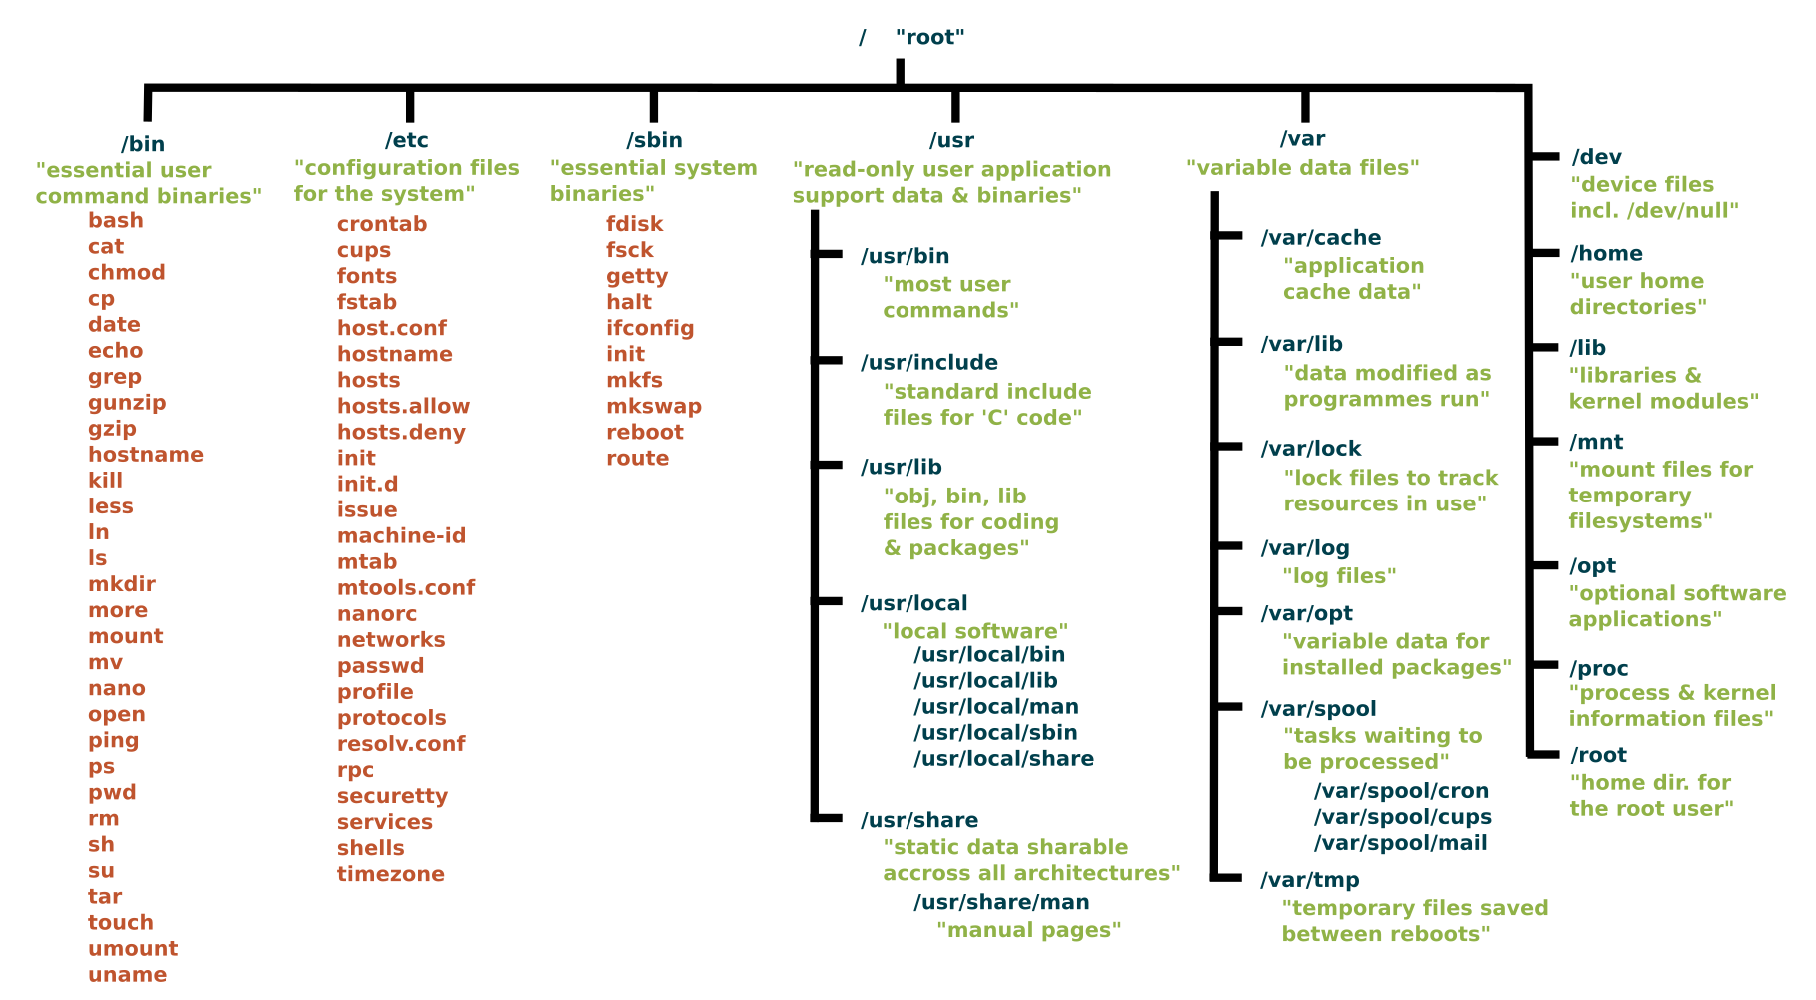
Linux File System see : https://www.linuxfoundation.org/blog/blog/classic-sysadmin-the-linux-filesystem-explained
#apt install tree
#tree –L 1 /

Slide 4
Shell in context!
user
screen
keyboard
SHELL
KERNEL
applications
HARDWARE
CPU, Memory, Disks, Printers

Slide 5
About ‘bash’ scripting
Bash
Bash is a command language interpreter. It is widely available on various operating systems and is a default command interpreter on most GNU/Linux systems. The name is an acronym for the ‘Bourne-Again SHell’.
Tells the Kernel what programs to use and how to run them
Shell
Shell is a macro processor which allows for an interactive or non-interactive command execution.
Scripting
Scripting allows for an automatic commands execution that would otherwise be executed interactively one-by-one.

Slide 6
What is in a Script?
Commands
Variables
Functions
Loops
Conditional Statements
Comments and Documentation
Options and Settings

Slide 7
Script Execution

Slide 8
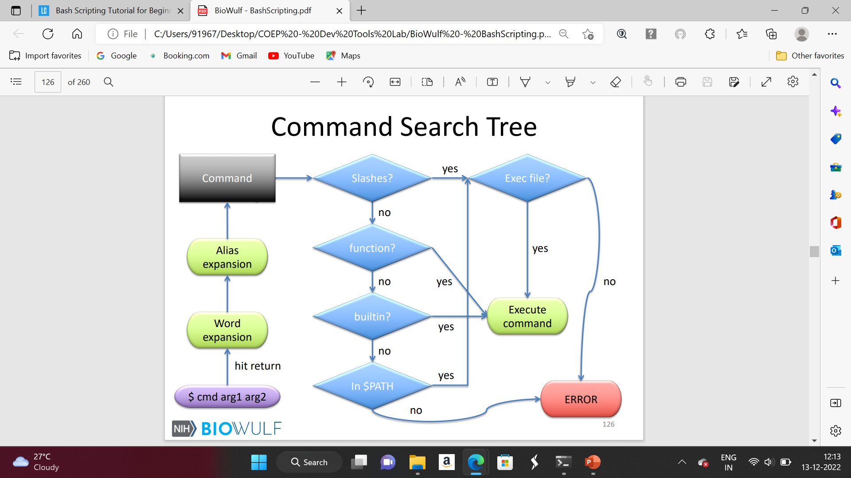
Command Execution

Slide 9
Script Execution – by calling bash
create a script and inspect it’s contents :
Text (A small script) is redirected to a file
$echo ‘echo Hello World! ’ > hello_world.sh
cat hello_world.sh
call it with bash:
Call bash – to interpret and execute the file
$bash hello_world.sh
results :
Hello World!

Slide 10
Multiline file creation
Before a command is executed, its input and output may be redirected using a special notation interpreted by the shell. Redirection may also be used to open and close files for the current shell execution environment.
Redirections are processed in the order they appear, from left to right. E.g. << first until ALLDONE, then > .
Here Documents ( << )
This type of redirection instructs the shell to read input from the current source until a line containing only delimiter (with no trailing blanks) is seen. All of the lines read up to that point are then used as the standard input for a command.
The format of here-documents is:
<<[-]word
here-document
delimiter
$ cat << ALLDONE > hello_world_multiline.sh
> echo Hello World!
> echo Yet another line.
> echo This is getting boring.
> ALLDONE
$
$ bash hello_world_multiline.sh
Hello World!
Yet another line.
This is getting boring.
$

Slide 11
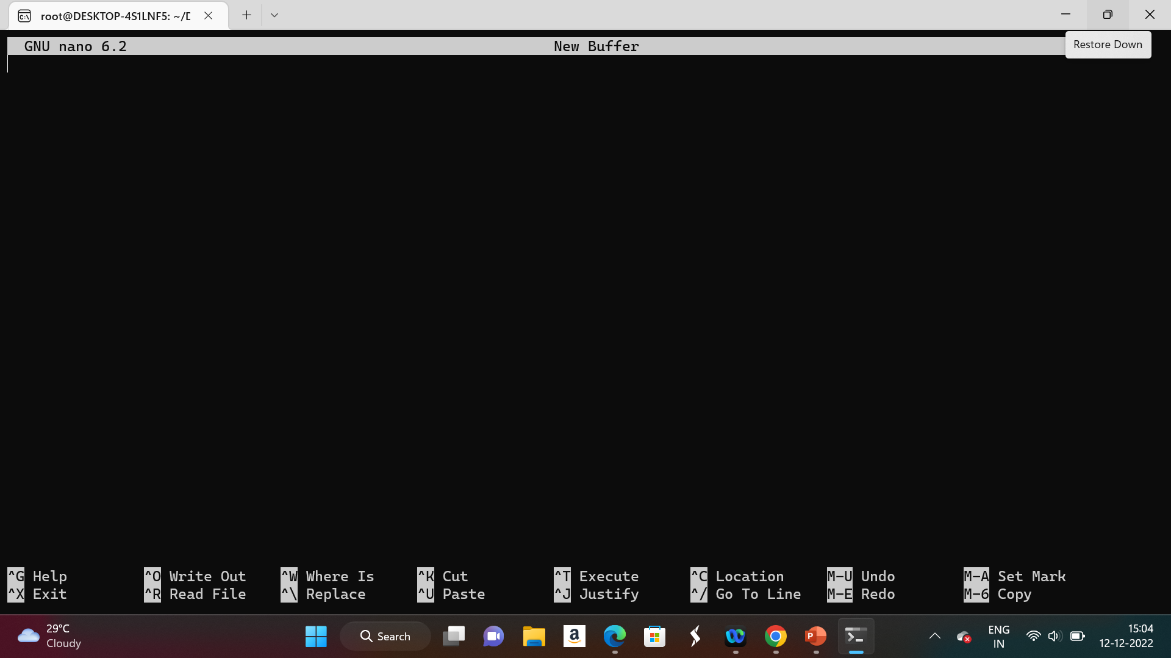
nano ….!

Slide 12
Script Execution with #! - shebang
cd DTL
touch hello-world.sh
nano hello-world.sh
chmod +x hello-world.sh
./hello-world.sh
Change to your working directory
Create an empty file with current timestamp
#!/bin/bash
#This is my hello-world bash script
echo “Hello World”
#! = shebang => path to shell of choice
$cat /etc/shells
Add execute permissions to u, g & o. Default is 644
Execute the script file

Slide 13
Debugging
Call bash with –x –v
$ bash –x –v hello_world.sh
#!/bin/bash –xv
echo Hello World!
-x displays commands and their results
-v displays everything, even comments and spaces
-xv can be combined. In fact, for shebang they MUST be combined

Slide 14
Special Parameters
Positional Parameters
Positional parameters are arguments passed to the shell when invoked
Denoted by ${digit}, where digit > 0. $0 is the name of the script – e.g. x.sh
Special Shell Parameters
Single character represents the parameter
$* - expands to all the positional parameters
$@ - the same as $*, but as array rather than string
$# - number of positional parameters
$- - current option flags when shell invoked
$$ - process id of the shell
$! - process id of last executed background command
$0 - name of the shell or shell script
$_ - final argument of last executed foreground command
$? - exit status of last executed foreground command
$ cat x.sh
#!/bin/bash
echo ${4} ${15} ${7} ${3} ${1} ${20}
$ bash x.sh {A..Z}
D O G C A T
EXPLANATION:
{A..Z} is a case of Brace Expansion. Sequence Expansion
The expanded seq is passed as an arg to x.sh
${digit} is selected “positionally” in the command, echo in this case.

Slide 15
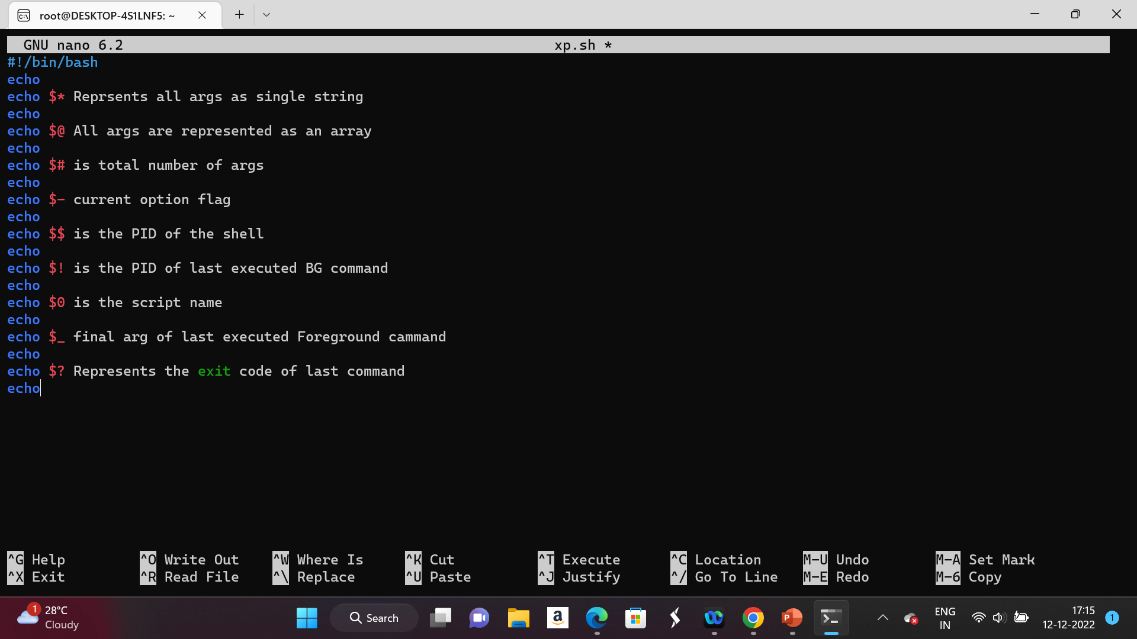
xp.sh – script to explore all special shell parameters

Slide 16
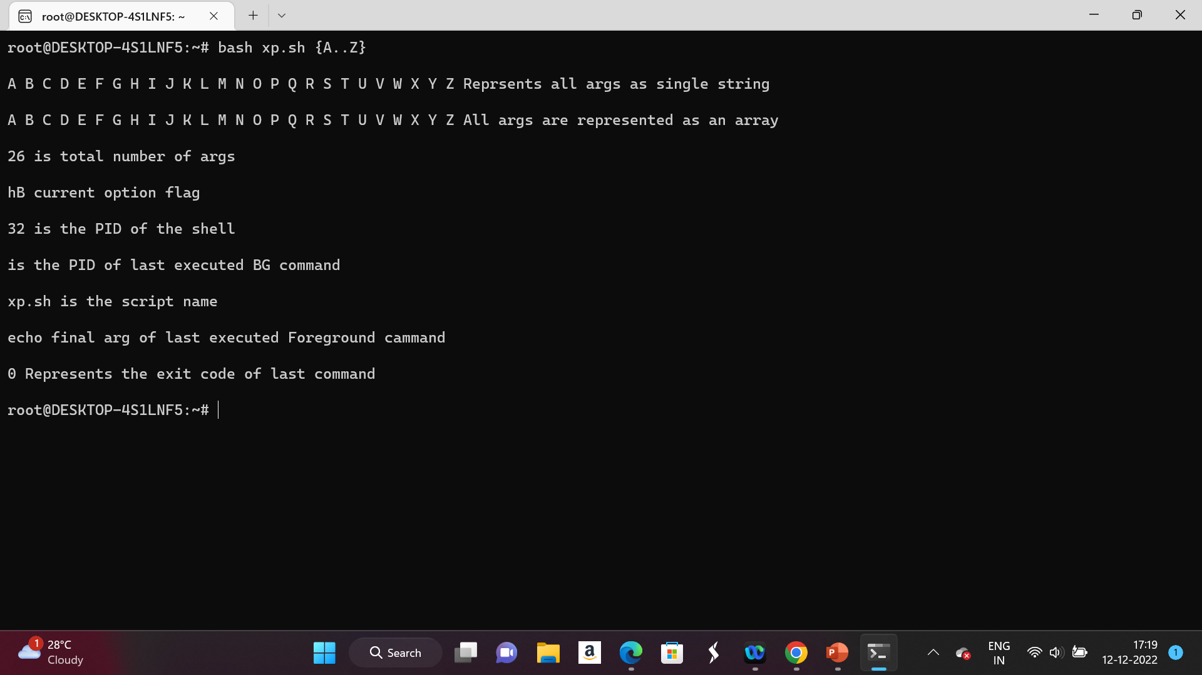
xp.sh – results

Slide 17
Shell Expansion 1 https://www.gnu.org/software/bash/manual/html_node/Shell-Expansions.html
Brace Expansion:
Patterns to be brace expanded take the form of an optional preamble, followed by either a series of comma-separated strings or a sequence expression between a pair of braces, followed by an optional postscript.
The preamble is prefixed to each string contained within the braces, and the postscript is then appended to each resulting string, expanding left to right
EXAMPLES :
$echo a{b,d,c}e
abe ade ace
$echo {A..Z}
A B C ……….Z
mkdir z{1..10}
ls
Parameter Expansion
A parameter is an argument supplied to a command / function / script.
$ is placed outside for parameter expansion
EXAMPLE
name=monster
echo $name
Braces can be used to preserve variable
echo ${name}_silly
More than one row
$ var1=cookie
$ var3=_is_silly
$ echo ${var1}_${name}${var3}

Slide 18
Shell Expansion – Arithmetic Expansion
Arithmetic Expansion
INTEGERS ONLY
((…)) => is used to evaluate math
$ is a must- for parameter expansion
$ echo ((12 – 7 )) is wrong
$ echo $((12 – 7 )) is correct
The ++ and -- operators only work on variables, and update the value
a=4
((a++))
echo $a
b=8
unset b
((b--))
echo $b
Variables can be updated, not just evaluated
a=4
b=8
echo $((a=a+b)
echo $a
Let and ((…)) are equivalent
a=1
let a++
echo $a

Slide 19
Shell Expansion – Command Substitution
Command Substitution => substitute the value returned by `command …` or $(command …)
Better to use $(…) than `…`
Try out 3 different echo
echo uname –n
echo `uname –n`
echo $(uname –n)

Slide 20
File names and permissions
Permissions.
System default permissions are 777 for directories and 666 for files. Usually, umask is 0022. So, usually files have 644 permissions, when they are created, i.e. –rw-r- - r - - .
To make shell scripts executable => chmod +x <script_file>
File extensions have no meaning to the system. They are mainly for your own reasons.
To see what is your file type:
$file <file_name>

Slide 21
VARIABLES

Slide 22
Variables
Variables => names for ‘values’ stored at specific memory locations. The programmer can store data in those locations, alter them and reuse them throughout the script
#!/bin/bash
greeting="Welcome"
user=$(whoami)
day=$(date +%A)
echo "$greeting back $user! Today is $day, which is the best day of the week!"
echo "Your Bash shell version is: $BASH_VERSION. Enjoy!"
NOTES:
$variable_name => access the value currently assigned to variable_name
greeting is a variable with (constant) string assigned to it
user and day are “COMMAND SUBSTITUTION” variables. The value assigned to them is generated by a the command in brackets.
$BASH_VERSION is an internal / shell variable. Such variables are in CAPITALS, to distinguish from user defined variables

Slide 23
Variables can be defined in the command line
:
linuxconfig.org:~$ a=4
linuxconfig.org:~$ b=8
linuxconfig.org:~$ echo $a
4
linuxconfig.org:~$ echo $b
8
linuxconfig.org:~$ echo $[$a + $b]
12
Variables can also be used directly on the terminal’s command line.
First variables a and b are declared with integer data.
Using echo command, we can print their values or even perform an arithmetic operation, Note echo is required to see the values. A command is necessary !
The $ is a must to interpret as a variable.
[EXPRESSION] is = test EXPRESSION
$[EXPRESSION] = value returned by EXPRESSION?
EXIT CODES $?

Slide 24
backup.sh - A script to backup any user’s home directory
#!/bin/bash
# This bash script is used to backup a user's home directory to /tmp/.
user=$(whoami)
input=/home/$user
output=/tmp/${user}_home_$(date +%Y-%m-%d_%H%M%S).tar.gz
tar -czf $output $input
echo "Backup of $input completed! Details about the output backup file:“
ls -l $output
Two new bash scripting concepts are introduced:
Firstly, our new backup.sh script contains comment line. Every line starting with # sign except shebang will not be interpreted by bash and will only serve as a programmer’s internal note.
Secondly, the script uses a new shell scripting trick ${parameter} called parameter expansion. In our case, curly braces {} are required because our variable $user is preceded by prefix followed by a suffix. The suffix includes $(date) – a command substitution.
The script will no longer be bind to a specific user. From now on our backup.sh bash script can be run by any user (others have r-x permission). while still backing up a correct user home directory

Slide 25
Three types of variables, based on scope
Local variables : Scope only within the instance of the script
Environment variables (ENVs) : Can have global / local scope.
To see ENV variables $env
e.g. PATH => all executables located
Global ENVs => accessible by all any process in the environment of the terminal.
$cat /etc/environment
$cat /etc/profile
$cat /etc/bash.bashrc
Local ENVs => specific scripts of the user
e.g. ~/.bashrc , ~/.bash_profile, ~/.bash_login, ~/.profile
Shell variables : variables required for proper functioning of all shell scripts. They are a mix of Global and Local ENVs

Slide 26
Setting the environment
The environment is a set of variables and functions recognized by the kernel and used by most programs
Not all variables are environment variables, must be exported
Initially set by startup files
printenv displays variables and values in the environment
set - Set or unset values of shell options and positional parameters.

Slide 27
Arrays – special type of variables
An array is a linear, ordered set of values.
The values are indexed by integers
Arrays are referenced by {} and []
array=(a b c) => note ( seq w/o ,), to declare array
echo ${array[*]} => a b c . $ for variable. {} for braces expansion. [] for indexing
echo ${array[2]} => 0 start indexing. So, c .
echo ${#array[*]} => NOTE #
# Loop thru an array - NOTE [@] => looping thru all elements
for chr in ${array[@]}; do
echo $chr
done
[*} vs [@}
[*] => concatenates all elements
for chr in “${array[@]}”; do echo $chr ; done
vs
for chr in “${array[*]}”; do echo $chr ; done

Slide 28
INPUT AND OUTPUT

Slide 29
Redirection
Every process has three file descriptors (file handles): STDIN (0), STDOUT (1), STDERR (2)
Content can be redirected
cmd < x.in
=> Redirect file descriptor 0 to x.in
cmd > x.out
=> Redirect file descriptor 1 to x.out
cmd 1> x.out 2> x.err
Redirect file descriptor 1 from STDOUT to x.out,
file descriptor 2 from STDERR to x.err
cmd > x.out 2>&1
Redirect file descriptor 1 from STDOUT to x.out,
then, redirect file descriptor 2 from STDERR to wherever descriptor 1 is pointing, i.e. x.out
cmd >> x.out
=> Append STDOUT to x.out
cmd 1>> x.out 2>&1
Combine STDOUT and STDERR. Append to x.out
ORDERING of redirections matter -> i.e. it is left to right

Slide 30
Input, Output and Error Redirections
linuxconfig.org:~$ ls -l foobar
ls: cannot access 'foobar': No such file or directory
linuxconfig.org:~$ touch foobar
linuxconfig.org:~$ ls -l foobar
-rw-r--r-- 1 linuxconfig linuxconfig 0 Jul 28 10:08 foobar
linuxconfig.org:~$
A NOTE ON EXIT STATUS
echo $?
0 => success
Non-zero => failure
127 => command not found
126 => command found, but not executable
An Error
No output. But foobar is created
A std output.

Slide 31
Redirecting stdout and stderr
linuxconfig.org:~$ ls foobar barfoo
ls: cannot access 'barfoo': No such file or directory
foobar
linuxconfig.org:~$ ls foobar barfoo > stdout.txt
ls: cannot access 'barfoo': No such file or directory
linuxconfig.org:~$ ls foobar barfoo 2> stderr.txt
foobar
linuxconfig.org:~$ ls foobar barfoo &>stdoutandstderr.txt
linuxconfig.org:~$ cat stdout.txt
foobar
linuxconfig.org:~$ cat stderr.txt
ls: cannot access 'barfoo': No such file or directory
linuxconfig.org:~$ cat stdoutandstderr.txt
ls: cannot access 'barfoo': No such file or directory foobar
The difference between stdout and stderr output is an essential concept. It allows us to redirect each output separately.
The > notation is used to redirect stdout to a file (say stdout.txt), instead of stdout (i.e TTY)
The 2> notation is used to redirect stderr, and not TTY.
And &> is used to redirect both stdout and stderr. No TTY output.
The cat command is used to display a content of any given file

Slide 32
The backup.sh script with error redirection
#!/bin/bash
# This bash script is used to backup a user's home directory to /tmp/.
user=$(whoami)
input=/home/$user
output=/tmp/${user}_home_$(date +%Y-%m-%d_%H%M%S).tar.gz
tar -czf $output $input 2> /dev/null
echo "Backup of $input completed! Details about the output backup file:"
ls -l $output
We can eliminate this unwanted stderr message by redirecting it with 2> notation to /dev/null.
Imagine /dev/null as a data sink, which discards any data redirected to it.
Data written to /dev/null is discarded (like Trash)

Slide 33
Redirecting stdin
Normally, terminal input comes from a keyboard. Any keystroke you type is accepted as stdin.
The alternative method is to accept command input from a file using < notation.
Consider the following example where we first feed cat command from the keyboard and redirecting the output to file1.txt. Later, we allow cat command to read the input from file1.txt using < notation
linuxconfig.org:~$ cat > file1.txt
I am using keyboard to input text.
Cat command reads my keyboard input, converts it to stdout which is instantly redirected to file1.txt
That is, until I press CTRL+D
linuxconfig.org:~$ cat < file1.txt
I am using keyboard to input text.
Cat command reads my keyboard input, converts it to stdout which is instantly redirected to file1.txt
That is, until I press CTRL+D

Slide 34
FUNCTIONS

Slide 35
Functions
Functions are a set of commands, grouped as a single function. This can be extremely useful if the output or calculation you require consists of multiple commands, and it will be expected multiple times throughout the script execution. Functions are defined by using the function keyword and followed by function body enclosed by curly brackets
$function status { date; uptime; who | grep $USER; }
$status
$declare –f status => displays code for the function
$export –f status => the function can be propagated to child shells
$unset status => the function is deleted

Slide 36
A code example – using function
#!/bin/bash
# This bash script is used to backup a user's home directory to /tmp/.
user=$(whoami)
input=/home/$user
output=/tmp/${user}_home_$(date +%Y-%m-%d_%H%M%S).tar.gz
# The function total_files reports number of files for a directory.
function total_files { find $1 -type f | wc –l }
# The function total_directories reports a total number of directories for a
# given directory.
function total_directories { find $1 -type d | wc –l }
tar -czf $output $input 2> /dev/null
echo -n "Files to be included:"
total_files $input
echo -n "Directories to be included:"
total_directories $input
echo "Backup of $input completed!"
echo "Details about the output backup file:"
ls -l $output

Slide 37
Numeric and String Comparisons

Slide 38
Numeric and String Comparisons
Using comparisons, we can compare strings ( words, sentences ) or integer numbers whether raw or as variables. The following table lists rudimentary comparison operators for both numbers and strings:
Description | Numeric Comparison | String Comparison
less than | -lt | <
greater than | -gt | >
equal | -eq | =
not equal | -ne | !=
less or equal | -le | N/A
greater or equal | -ge | N/A

Slide 39
Numeric Comparison
Say, we would like to compare numeric values like two integers 1 and 2. The alongside example will first define two variables $a and $b to hold our integer values.
Next, we use square brackets and numeric comparison operators to perform the actual evaluation. NOTE : [ EXPR ] is –eq to test if T/F .
Using echo $? command, we check for a return value of the previously executed evaluation. There or two possible outcomes for every evaluation, true or false. If the return value is equal to 0, then the comparison evaluation is true. However, if the return value is equal to 1, the evaluation resulted as false.
linuxconfig.org:~$ a=1
linuxconfig.org:~$ b=2
linuxconfig.org:~$ [ $a -lt $b ]
linuxconfig.org:~$ echo $?
0
linuxconfig.org:~$ [ $a -gt $b ]
linuxconfig.org:~$ echo $?
1
linuxconfig.org:~$ [ $a -eq $b ]
linuxconfig.org:~$ echo $?
1
linuxconfig.org:~$ [ $a -ne $b ]
linuxconfig.org:~$ echo $?
0
linuxconfig.org:~$
NOTE : echo $? Must be used. Else you will get error status 127

Slide 40
Comparing strings
linuxconfig.org:~$ [ "apples" = "oranges" ]
linuxconfig.org:~$ echo $?
1
linuxconfig.org:~$ str1="apples" linuxconfig.org:~$ str2="oranges" linuxconfig.org:~$ [ $str1 = $str2 ]
linuxconfig.org:~$ echo $?
1
linuxconfig.org:~$

Slide 41
Code example using comparisons
#!/bin/bash
string_a="UNIX“
string_b="GNU"
echo "Are $string_a and $string_b strings equal?" [ $string_a = $string_b ]
echo $?
num_a=100
num_b=100
echo "Is $num_a equal to $num_b ?" [ $num_a -eq $num_b ]
echo $?

Slide 42
CONDITIONAL STATEMENTS

Slide 43
If .. elif .. else .. fi
if test-commands ; then
consequent-commands
elif more-test-commands ; then
more-consequents
else
alternate-consequents
fi
# EXAMPLE CODE
if test -e ~/.bashrc; then
echo "~/.bashrc exists"
elif test -e ~/.bash_profile; then
echo "~/.bash_profile exists"
else echo "You may not be running bash"
fi
[ and [[ are substitute for the test command
[ is an executable file
which [ => /usr/bin/[

Slide 44
Backup script again- with conditionals
#!/bin/bash
user=$(whoami)
input=/home/$user
output=/tmp/${user}_home_$(date +%Y-%m-%d_%H%M%S).tar.gz
function total_files { find $1 -type f | wc –l }
function total_directories { find $1 -type d | wc –l }
function total_archived_directories {
tar -tzf $1 | grep /$ | wc -l
}
function total_archived_files { tar -tzf $1 | grep -v /$ | wc –l }
tar -czf $output $input 2> /dev/null
src_files=$( total_files $input )
src_directories=$( total_directories $input )
arch_files=$( total_archived_files $output )
arch_directories=$( total_archived_directories $output )
echo "Files to be included: $src_files"
echo "Directories to be included: $src_directories"
echo "Files archived: $arch_files"
echo "Directories archived: $arch_directories"
if [ $src_files -eq $arch_files ]; then
echo "Backup of $input completed!"
echo "Details about the output backup file:"
ls -l $output
else
echo "Backup of $input failed!"
fi
Blank Line after fi required

Slide 45
Conditional for Arithmetic expressions
a=4
if ((a==4)) ; then echo yes ; else echo no ; fi
yes
if (( (a-5) == 0 )) ; then echo yes ; else echo no ; fi
no
if (( a < 10 )) ; then echo yes ; else echo no ; fi
yes
BE CAREFUL : == and = are not the same
a=4
if (( a = 5 )) ; then echo yes ; else echo no ; fi
yes

Slide 46
Bash Loops – Looping Constructs
GENERAL NOTE : wherever a ‘;’ appears in the description of a command’s syntax, it may be replaced with one or more newlines
until
Syntax : until test-commands; do consequent-commands; done
Execute consequent-commands as long as test-commands has an exit status which is not zero. The return status is the exit status of the last command executed in consequent-commands, or zero if none was executed.
while
Syntax : while test-commands; do consequent-commands; done
Execute consequent-commands as long as test-commands has an exit status of zero. The return status is the exit status of the last command executed in consequent-commands, or zero if none was executed.
for
Syntax : for name [ [in [words …] ] ; ] do commands; done
Expand words (see Shell Expansions), and execute commands once for each member in the resultant list

Slide 47
big_backup.sh
#!/bin/bash
# This bash script is used to backup a user's home directory to /tmp/.
function backup {
if [ -z $1 ]; then
user=$(whoami)
else
if [ ! -d "/home/$1" ]; then
echo "Requested $1 user home directory doesn't exist."
exit 1
fi
user=$1
fi
[ -z $1 ]
-z checks 1st positional parameter supplied to backup function zero length. -z returns TRUE if zero
[ !-d “/home/$1” ]
By default –d returns true if directory exists. So, !-d => no directory exists.
If [No dir] exit with error status 1

Slide 48
big_backup.sh …contd
input=/home/$user
output=/tmp/${user}_home_$(date +%Y-%m-%d_%H%M%S).tar.gz
function total_files {
find $1 -type f | wc -l
}
function total_directories {
find $1 -type d | wc -l
}
function total_archived_directories {
tar -tzf $1 | grep /$ | wc -l
}
function total_archived_files {
tar -tzf $1 | grep -v /$ | wc -l
}
tar -czf $output $input 2> /dev/null
src_files=$( total_files $input )
src_directories=$( total_directories $input )
arch_files=$( total_archived_files $output )
arch_directories=$( total_archived_directories $output )
echo "########## $user ##########"
echo "Files to be included: $src_files"
echo "Directories to be included: $src_directories"
echo "Files archived: $arch_files"
echo "Directories archived: $arch_directories"

Slide 49
Big_backup.sh … contd
if [ $src_files -eq $arch_files ]; then
echo "Backup of $input completed!"
echo "Details about the output backup file:"
ls -l $output
else
echo "Backup of $input failed!"
fi
}
for directory in $*; do
backup $directory
done;
To execute, you need to provide $1, which is typically a $user, e.g. :
./big_backup.sh ramesh Sheela jenny
Note for loop => for multiple users, create the backup of their home directory(s). $* parameter expansion

Slide 50
BASH ARITHMETICS

Slide 51
Arithmetic Expansion
linuxconfig.org:~$ a=$(( 12 + 5 ))
linuxconfig.org:~$ echo $a
17
linuxconfig.org:~$ echo $(( 12 + 5 ))
17
linuxconfig.org:~$ echo $(( 100 - 1 ))
99
linuxconfig.org:~$ echo $(( 3 * 11 ))
33
linuxconfig.org:~$ division=$(( 100 / 10 ))
linuxconfig.org:~$ echo $division
10
linuxconfig.org:~$ x=10;y=33
linuxconfig.org:~$ z=$(( $x * $y ))
linuxconfig.org:~$ echo $z
330
The arithmetic expansion is the simplest method to achieve basic calculations.
We just enclose any mathematical expression inside double parentheses.
Alongside => simple addition, subtraction, multiplication and division calculations with integers.
To do floating point arithmetic utilies such as bc is required.

Slide 52
expr command
linuxconfig.org:~$ expr 2 + 2
4
linuxconfig.org:~$ expr 6 * 6 expr:
syntax error
linuxconfig.org:~$ expr 6 \* 6
36
linuxconfig.org:~$ expr 6 / 3
2
linuxconfig.org :~$ expr 1000 - 999
1
linuxconfig.org:~$
Using the expr command allows us to perform an arithmetic operation even without enclosing our mathematical expression within brackets.
NOTE:
Do not forget to escape asterisk multiplication sign to avoid expr: syntax error
Divide is ‘/’

Slide 53
let command
linuxconfig.org:~$ let a=2+2
linuxconfig.org:~$ echo $a
4
linuxconfig.org:~$ let b=4*($a-1) linuxconfig.org:~$ echo $b
12
linuxconfig.org:~$ let c=($b**3)/2 linuxconfig.org:~$ echo $c
864
linuxconfig.org:~$ let c++
linuxconfig.org:~$ echo $c
865
linuxconfig.org:~$ let c–
linuxconfig.org:~$ echo $c
864
linuxconfig.org:~$
Similar to expr command, we can perform bash arithmetic operations with let command.
let command evaluates a mathematical expression and stores its result into a variable.
See alongside examples of let :
to perform integer increment and decreament.
exponent operations like x³

Slide 54
bc command
linuxconfig.org:~$ echo '8.5 / 2.3' | bc
3
linuxconfig.org:~$ echo 'scale=2;8.5 / 2.3' | bc
3.69
linuxconfig.org:~$ echo 'scale=30;8.5 / 2.3' | bc
3.695652173913043478260869565217
linuxconfig.org:~$ squareroot=$( echo 'scale=50;sqrt(50)' | bc )
linuxconfig.org:~$ echo $squareroot 7.07106781186547524400844362104849039284835937688474
linuxconfig.org:~$

Slide 55
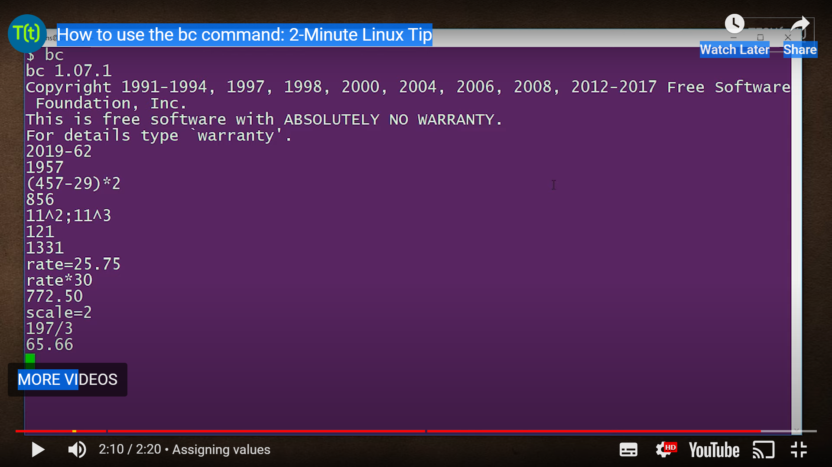
Another way to use bc – like a calculator
Type quit to quit bc

